Slide 1
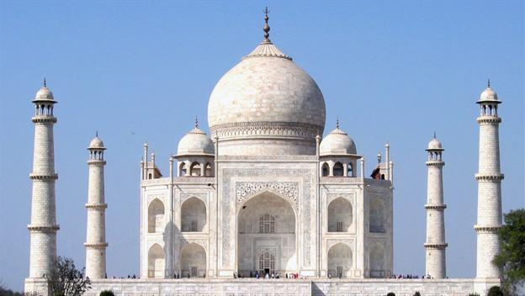
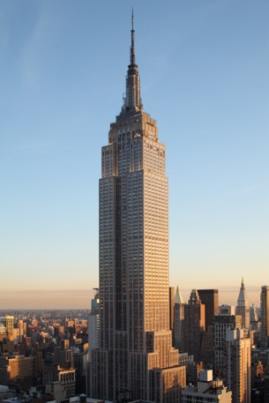
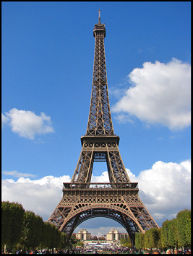
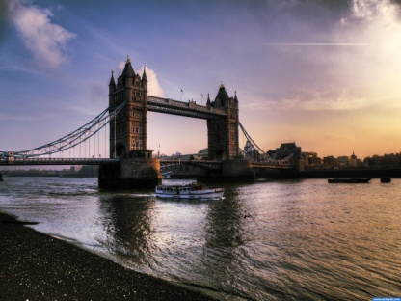
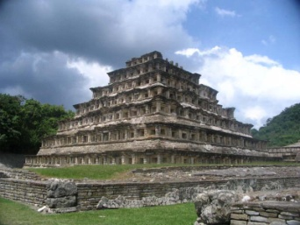
Architecture
Buildings-Monuments-Structures
Throughout History

Slide 2
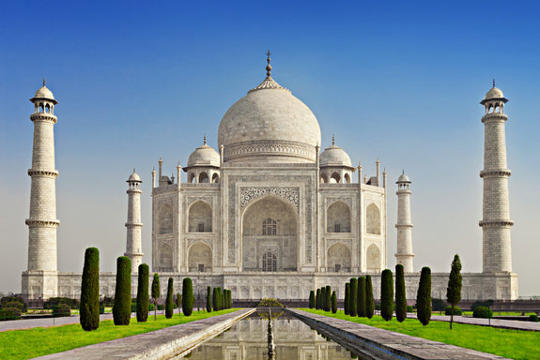
Taj Mahal
Located in: India
The Taj Mahal
took 17 years to
complete.
More then 1,000
elephants were employed to transport materials.

Slide 3
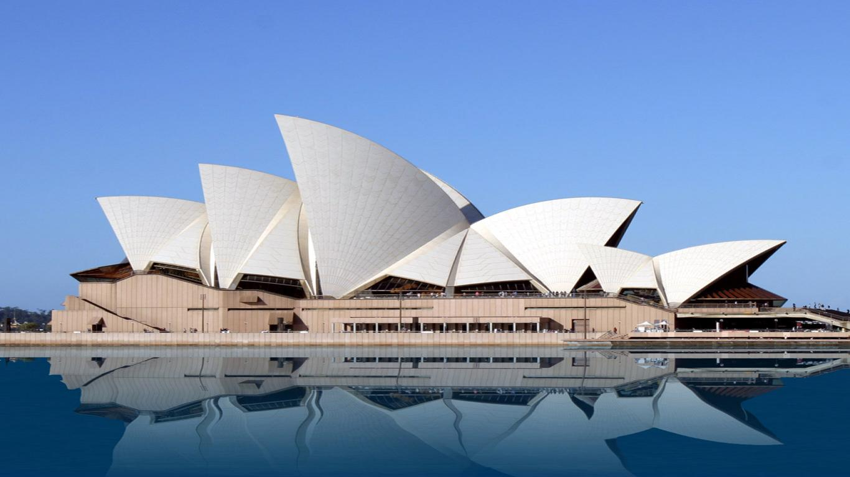
Sydney Opera House
Located in:
Australia
The work to
build the opera
house started in
1959 ended in 1973
The Sydney Opera House has approximately 1,000 rooms.

Slide 4
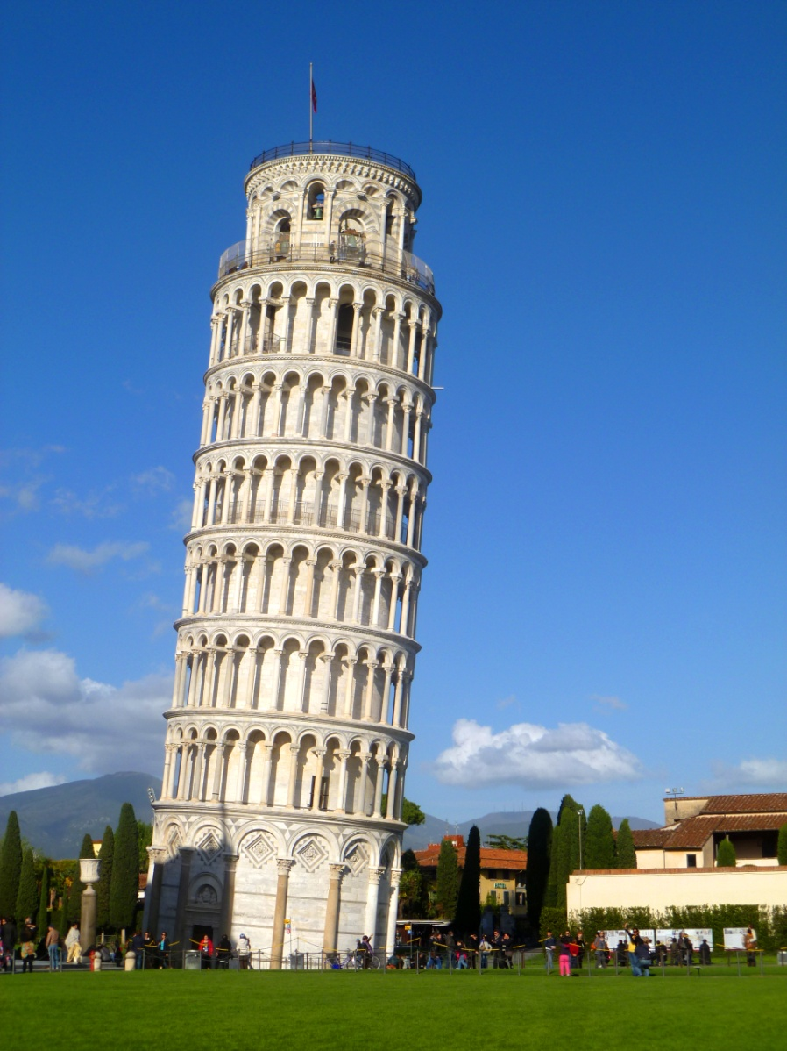
Leaning Tower of Pisa
Located in: Italy
The tower took about
800 years to finish. Mostly
Because of “leaning
confusion”.
The tower has 294 steps
to reach the top.

Slide 5
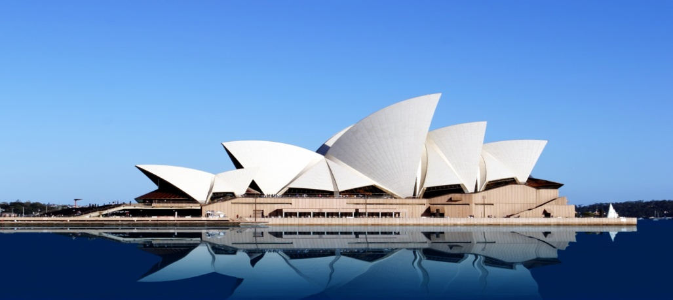
Taj Mahal VS. The Sydney Opera House
Taj Mahal
Similarities
Sydney Opera House
Baroque styled
Contains lots of tower like places
Built in India
Domes
Both are around a body of water
Modern styled
Contains a lot of arched triangle roof pieces
Located in Australia
columns

Slide 6
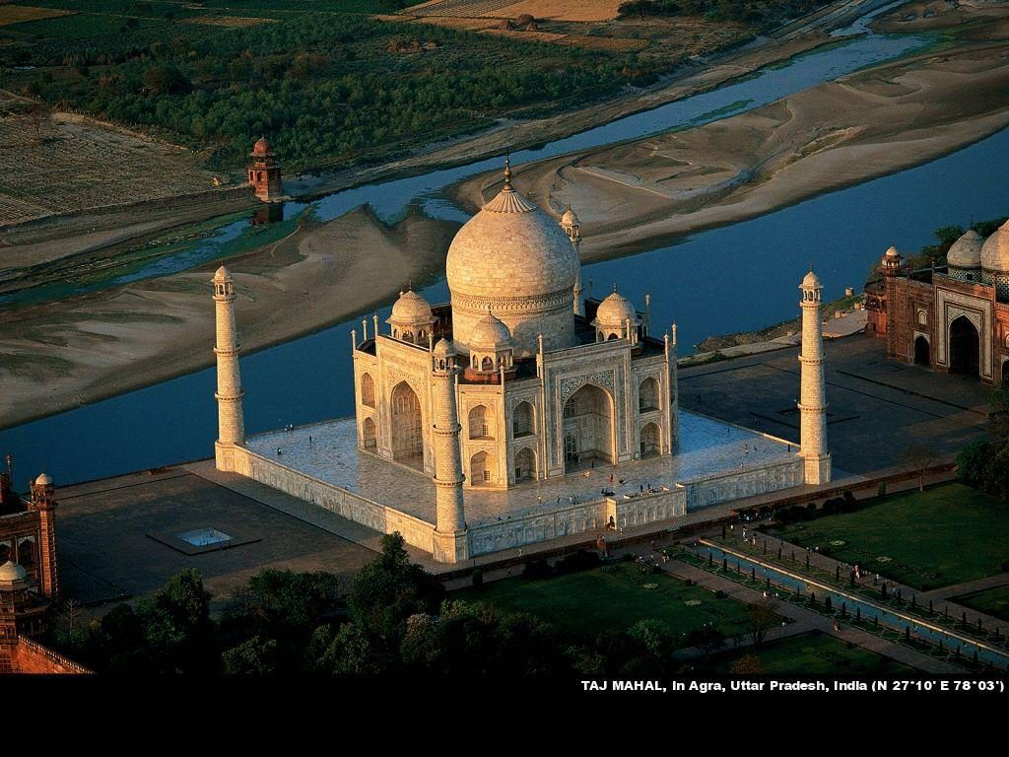
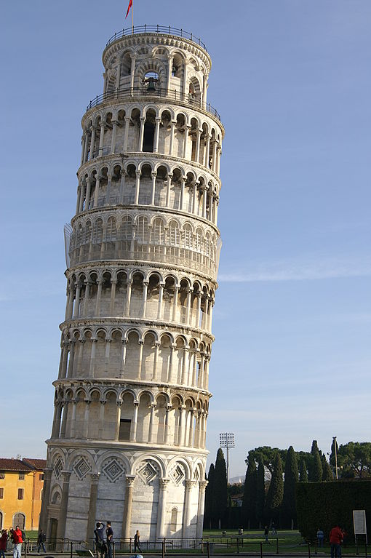
Taj Mahal VS. Leaning Tower of Pisa
Taj Mahal
Similarities
Leaning Tower of Pisa
Baroque styled
Built in India
Has many domes
Romanesque styled
Built in Italy
So many columns
Both are white and tower into the sky over 180 feet.]
Both have tons of details

Slide 7
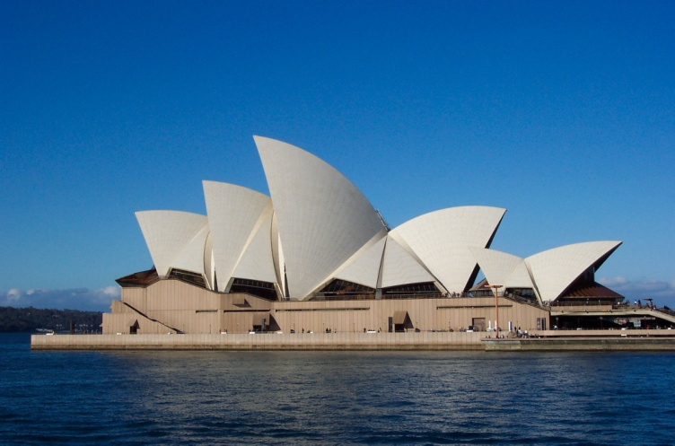
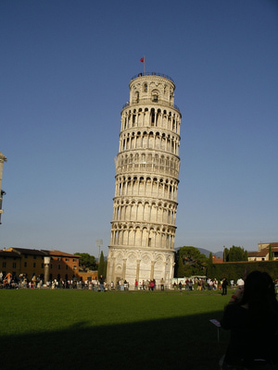
Sydney Opera house VS. The Leaning Tower Of Pisa
Sydney Opera House
The Leaning tower of Pisa
Tiled roof
220 feet tall
Similarities
Both are major tourist attractions
The Leaning Tower of Pisa is 183 feet tall
Lots of colmns holding up the next floor.

